Slide 1
PV array
Disconnect
DC
AC Mains
double pole breaker (30A)?
Charge Controller with MPPT
AC Breaker Panel
DC /DC
120V vs 240V?
125A Fuse
Inverter
DC Bus
AC /DC
AC
Disconnect
Smart Meter
20A
15A
15A
60A ‘breaker’?
DC
Disconnect
DC Sub-
Panel
LED circuit
DC outlet
‘switched’ appliances for load advancement and deferral
Battery Bank

Slide 2
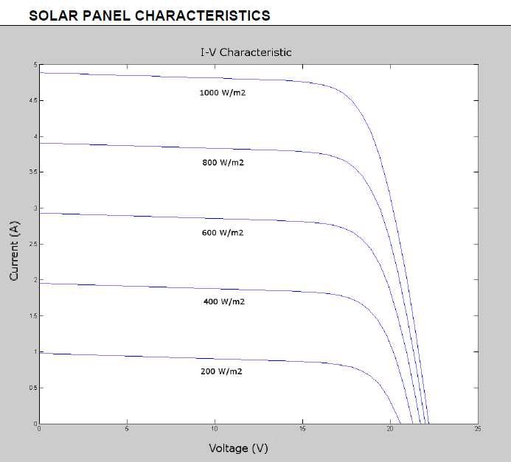
Charge Controller with MPPT
Disconnect
DC
DC/DC
Inverter
DC Bus
AC /DC
DC
Disconnect
Battery Bank

Slide 3
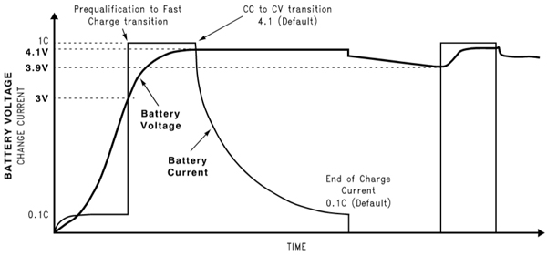
Charge Controller with Voltage Regulation: Battery Management
DC /DC
Inverter
DC Bus
AC /DC
DC
Disconnect
60A ‘breaker’?
DC Sub-
Panel
Overcharge Protection
Thermal Management
Voltage/Current Regulation
Minimize leakage current
LED circuit
DC outlet
Battery Bank

Slide 4
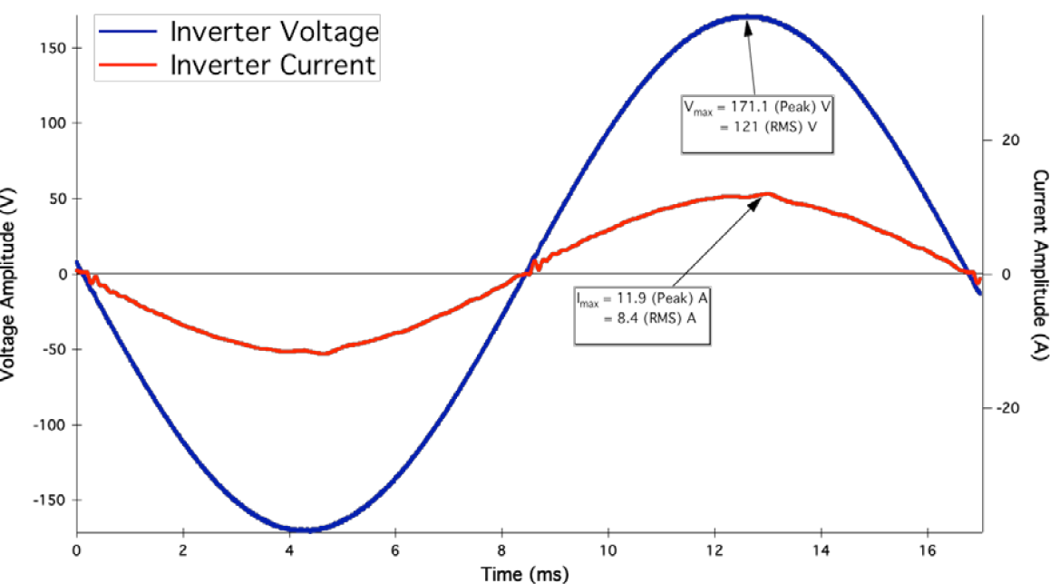
Bidirectional Charge Converter/Inverter
DC /DC
Inverter
DC Bus
AC /DC
60A ‘breaker’?
DC
Disconnect
LED circuit
DC outlet
Characterize power requirements of loads-battery bank sufficient?
Possibility of providing short-term grid support from battery reserve
User specify direction of current flow
How to test?

